Slide 1
Coding and Decoding

Slide 3
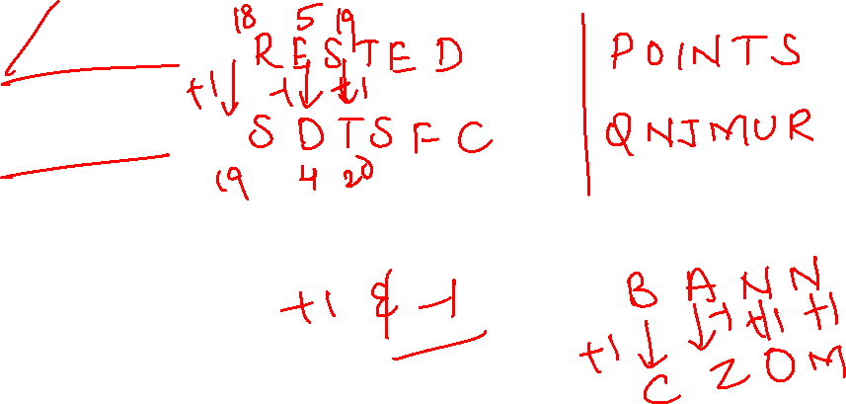
1.In certain code language “RESTED” is coded as SDTSFC and POINTS is coded as QNJMUR. How is BANNED written in that code language?
A. CZOMFC
B. ABMODE
C. CZOODE
D. ABMMFC

Slide 4
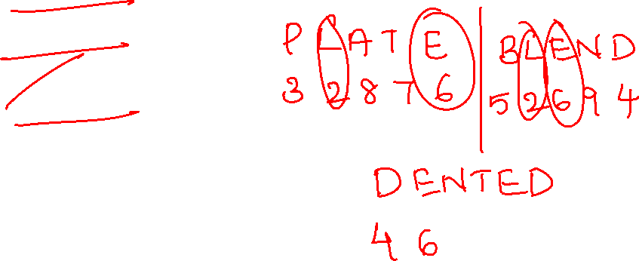
2. In a certain code language “PLATE” is written as “32876” and “BLEND” is written as “ 52694”. How is “DENTED” written in that code language?
A. 869768
B. 295329
C. 469764
D. 538635

Slide 5
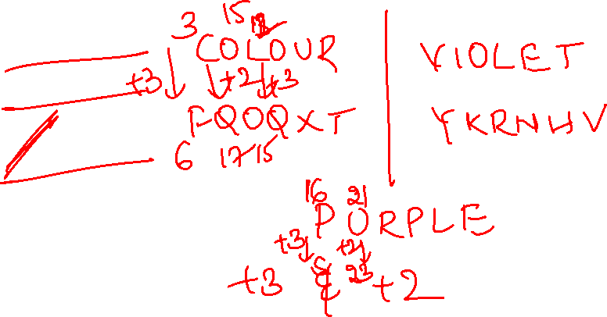
3. In a certain code language ‘COLOUR’ is written as ‘FQOQXT’ and ‘VIOLET’ is written as ‘YKRNHV’. How will ‘PURPLE’ be written in that language?
A. SXUSOG
B. RWUSPH
C. SWUROG
D. RXWSOH

Slide 6
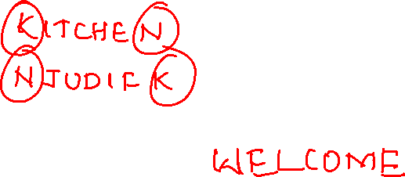
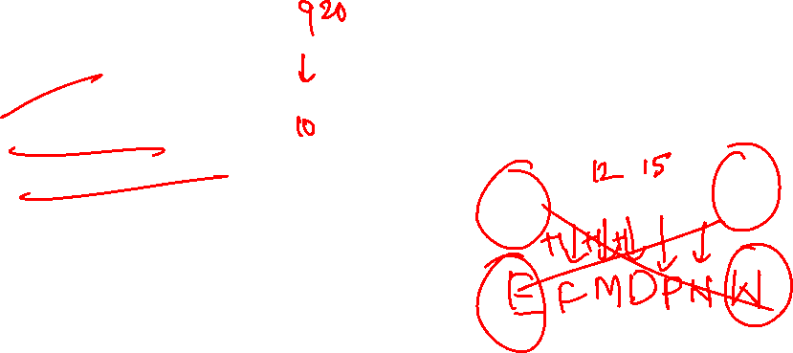
4. In a certain code language ‘KITCHEN’ is written as NJUDIFK and ‘RESPECT’ is weitten as TFTQFDR. How iwill WELCOME be written In that language?
A. EFMDQNE
B. EFMDPNW
C. ZLEOCEW
D. ZDMBONW

Slide 7
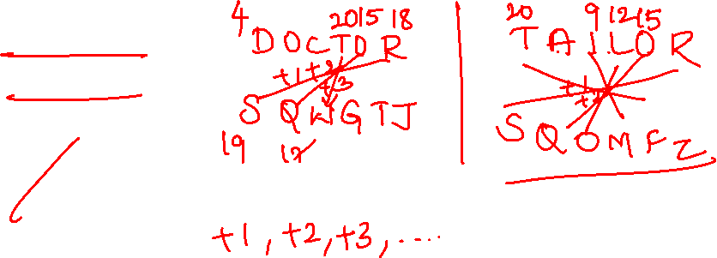
5. In a certain code language ‘DOCTOR’ is written as ‘SQWGTJ’ and ‘SINGER’ is written as ‘SGJRNY’. How will ‘TAILOR’ be written in that language?
A. TOOMFZ
B. TQQNEZ
C. SQOMFX
D. SQOMFZ

Slide 8
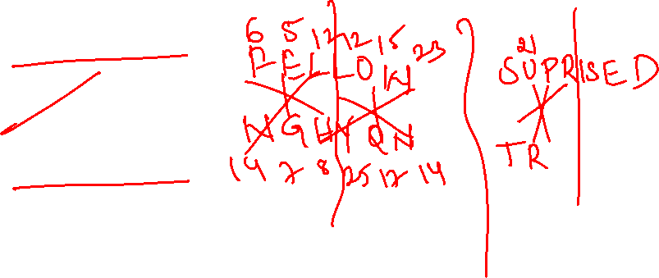
6. In a certain code language ‘FELLOW’ is written as ‘NGHYQN’ and ‘PURPLE’ is written as ‘TWRGNR’. how will ‘SUPRISED’ be written in that language?
A. KUGFUWRT
B. TRWUFGUK
C. TRUWFGUK
D. UWRTKUGF

Slide 9
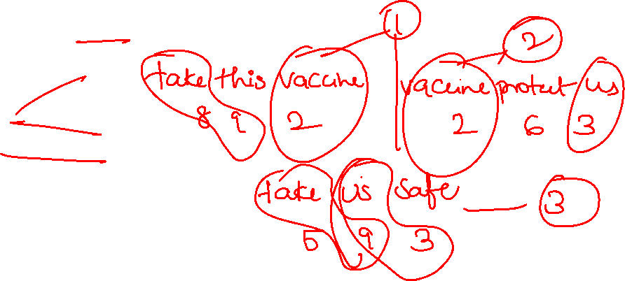
7. In a certain code language ‘take this vaccine’ is written as ‘892’ ‘vaccine protect us’ is coded as ‘263’, and ‘ take us safe’ is written as ‘593’. How will ‘safe vaccine’ be written in that language?
A. 85
B. 25
C. 23
D. 26

Slide 10
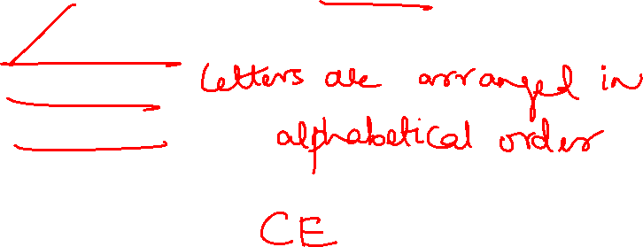
8. In a certain code language, ‘LEMON’ is coded as ‘ELMNO’ and ‘MANGO’ is coded as ‘AGMNO’. How will ‘CLUSTER’ be written in that language?
A. CELRSTU
B. CLESRUT
C. LUCETRS
D. LCUTESR

Slide 11
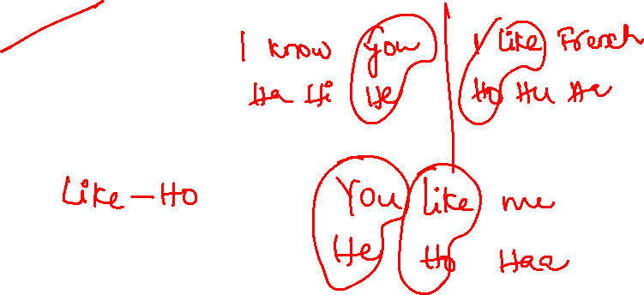
9. In a certain code language ‘I know you’ is written as ‘Ha Hi He’. I Like French’ is coded as ‘Ho Hu Ha’ and ‘You like me’ is coded as ‘He Ho Haa’. How will ‘me’ be written in that language?
A. Haa
B. Hu
C. Ha
D. Hi

Slide 12
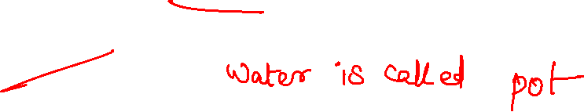
10. If sky is called ‘cloud’, cloud is called ‘thunder’, thunder is called ‘water’, water is called ‘pot’, pot is called ‘desert’ and desert is called ‘sky’, then where do fish live?
A. cloud
B. pot
C. water
D. desert

Slide 13
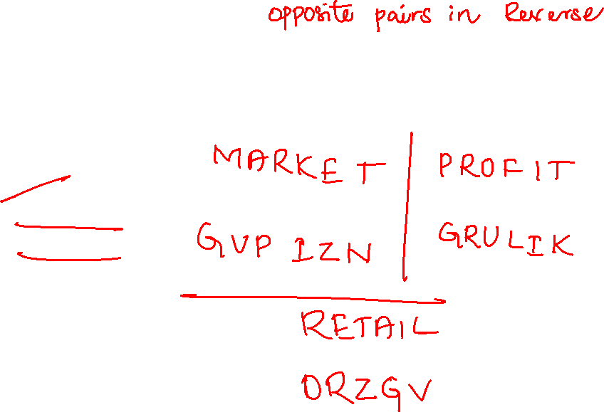
11. In a certain code language ‘MARKET’ is written as ‘GVPIZN’ and ‘PROFIT’ is written as ‘GRULIK’. How will RETAIL be written in that language?
A. ORZGUI
B. ORZGVI
C. ORBGVI
D. ORBGUI

Slide 14
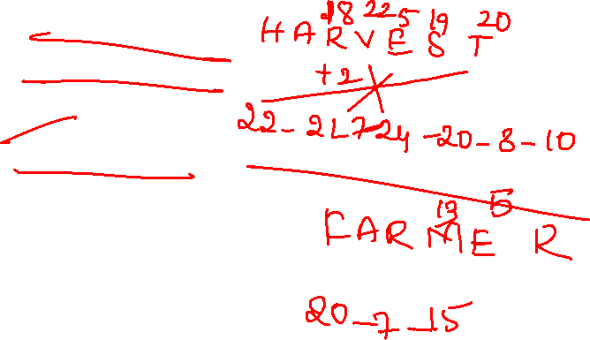
13. In a certain code language ‘HARVEST’ is coded as 22-21-7-24-20-3-10 and ‘PLANTS’ is coded as 21-22-16-3-14-18. how will ‘FARMER’ be coded in that language?
A. 19-7-15-19-3-8
B. 19-7-15-20-3-7
C. 20-7-15-20-3-8
D. 20-7-14-21-3-8

Slide 15
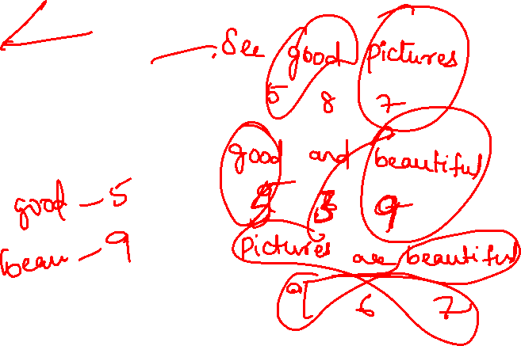
14. In a certain code language ‘587’ is codded as ‘see good pictures’, ‘539’ is coded as ‘good and beautiful’ and ‘967’ is written as ‘pictures are beautiful’. What is the code for the word ‘see’ in that language?
A. 8
B. 7
C. 6
D. 5

Slide 16
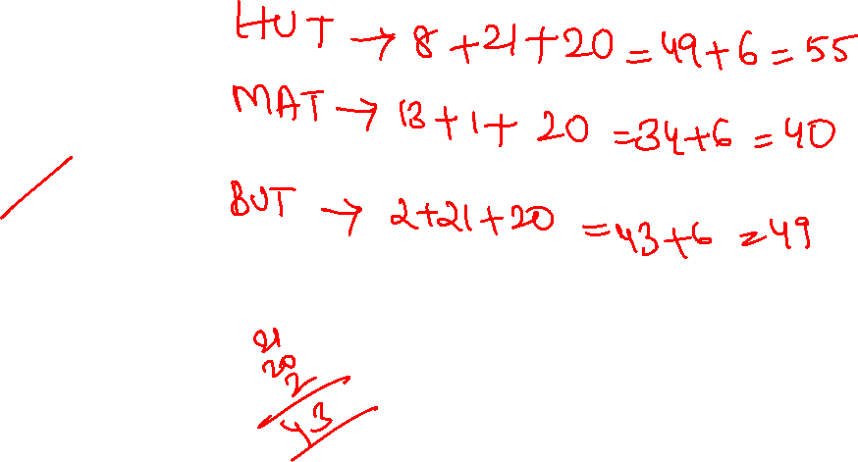
15. In a certain code language, HUT is coded as 55 and MAT is coded as 40. how will BUT be coded in that language?
A. 19
B. 20
C. 21
D. 18
E. none

Slide 17
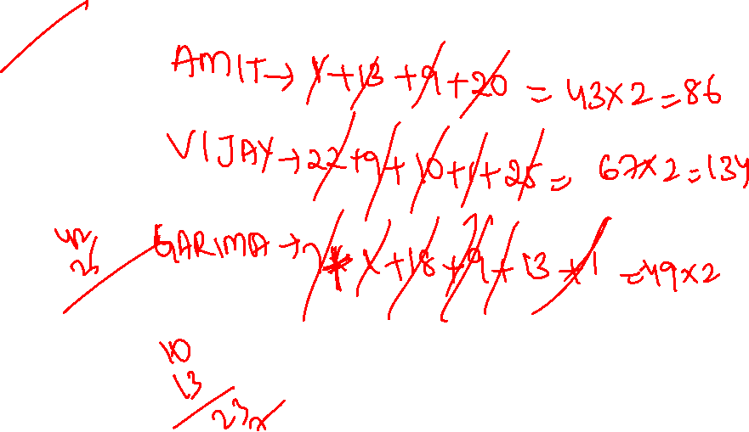
16. In a certain code language ‘AMIT’ is coded as 86 and ‘VIJAY’ is coded as 134. How will GARIMA be coded in the same language?
A. 98
B. 49
C. 78
D. 67

Slide 18
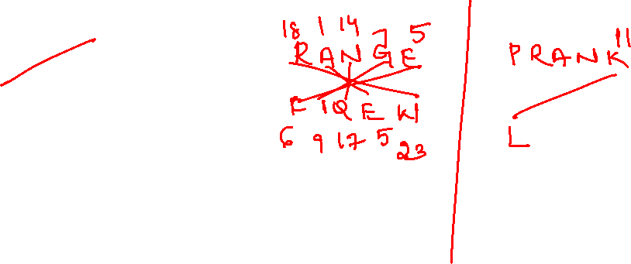
17. In a certain code language, ‘RANGE’ is written as ‘FIQEW’ and ‘ARANGE’ is coded as ‘FIDVF’. How will ‘PRANK’ written in that code ?
A. MQEWV
B. LPDVU
C. UVDPL
D. VWEQM

Slide 19
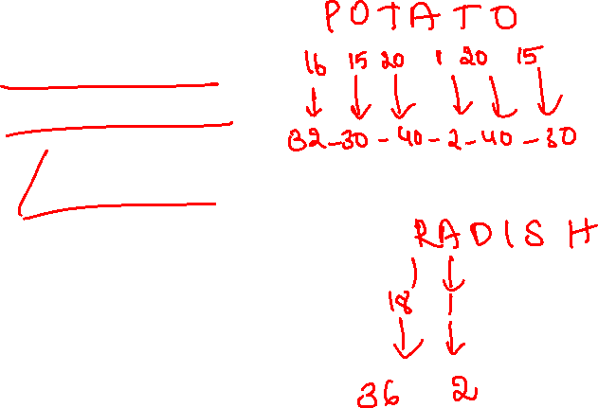
18. In a certain code language ‘POTATO’ is coded as 32-30-40-2-40-30 and ‘TURNIP’ is coded as 40-42-36-28-18-32. How will ‘RADISH’ be coded in that language ?
A. 36-1-4-19-16-8
B. 18-2-4-19-18-20
C. 18-1-8-38-18-20
D. 36-2-8-18-38-16

Slide 20
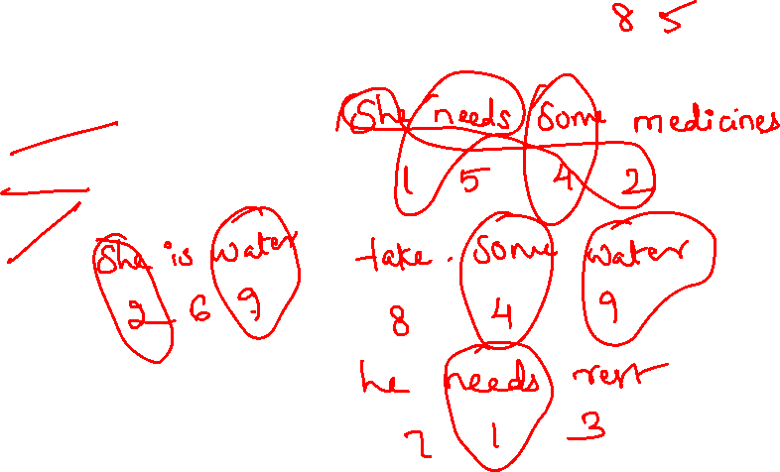
19. In a certain code language ‘she needs some medicines’ is written as ‘1542’, ‘take some water’ is written as ‘489’, he needs rest’ is written as ‘713’ and ‘she has water’ is written as ‘296’. How will ‘ take medicines’ be written in that language?
A. 45
B. 92
C. 85
D. 81

Slide 21
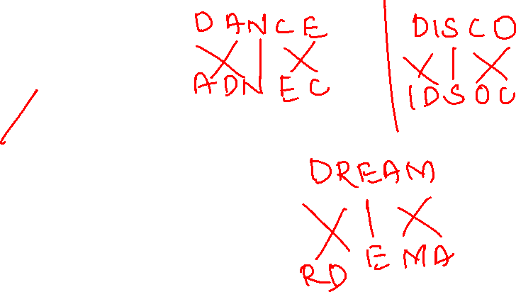
20. In a certain code language ‘DANCE’ is coded as ‘ADNEC’ and ‘DISCO’ is written as ‘IDSOC’. How will ‘DREAM’ be written in that code?
A. DREMA
B. RAEMO
C. RDEAM
D. RDEMA

Slide 22
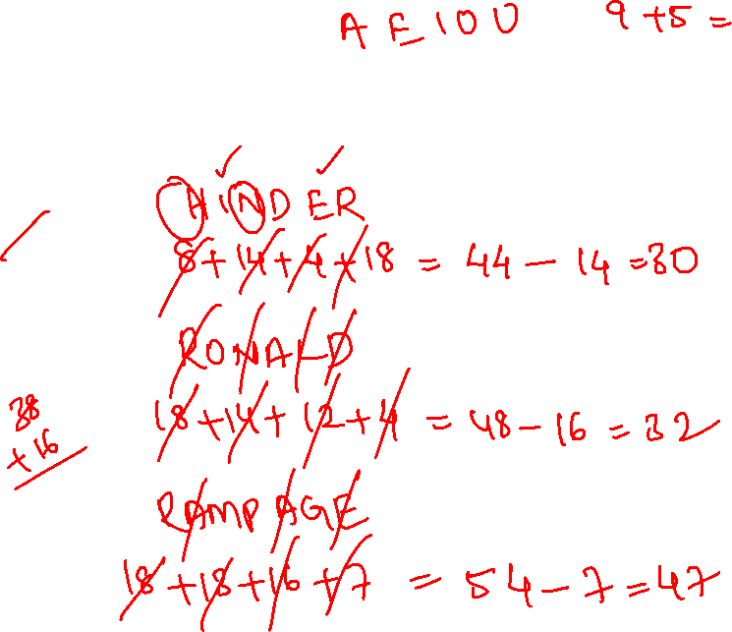
21. In a certain code ‘HINDER’ is code as 30, ‘RONALD’ is coded as 32 then how will RAMPAGE be coded in that languge?
A. 37
B. 47
C. 36
D. 51

Slide 23
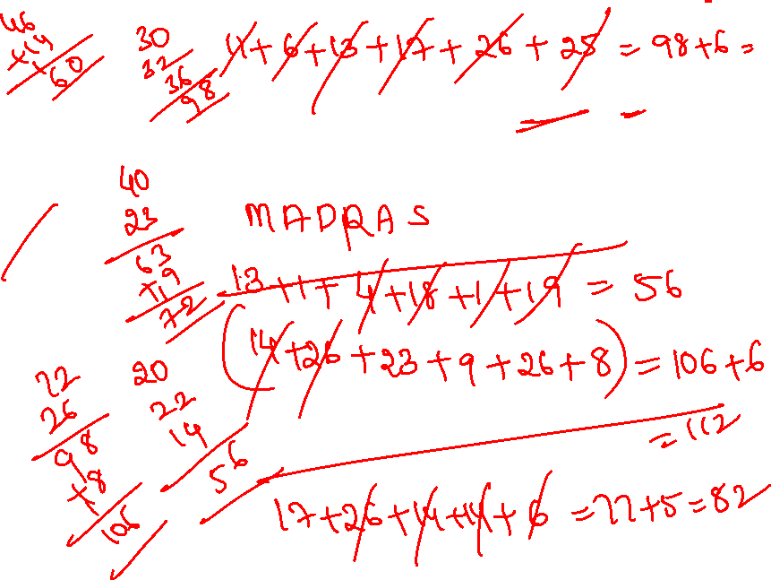
22. In a certain code language ‘MADRAS’ is coded as 112 and ‘JAMMU’ is coded as 82. how will ‘PUNJAB’ be written in that language?
A. 109
B. 104
C. 112
D. 115

Slide 24
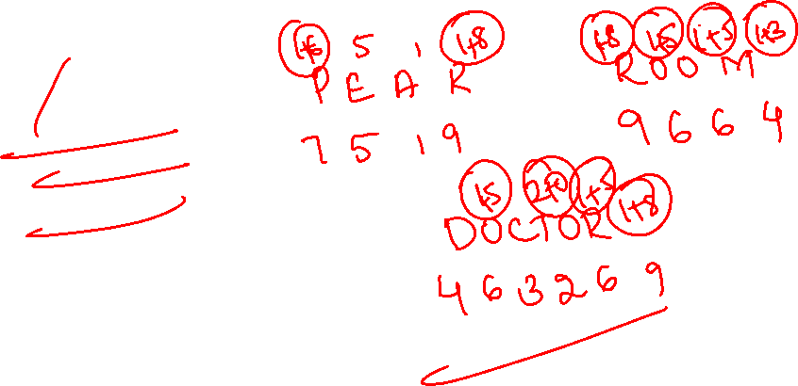
23. If PEAR is coded as 7519 and ROOM is coded as 9664 then how will DOCTOR be coded as
A. 463269
B. 463729
C. 463296
D. 463239

Slide 25
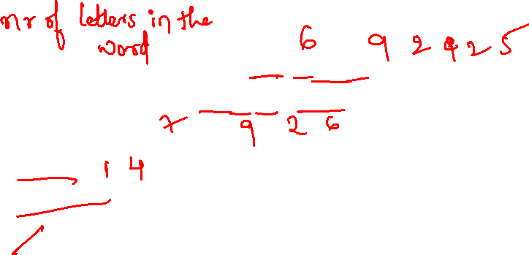
24. In a certain code language ‘school education is free in India’ is coded as 692425 and ‘college education is costly’ is coded as 7926. what is the code for ‘I want to become graduate’?
A. 23586
B. 54268
C. 14268
D. 15426

Slide 26
25. In a certain code language, if yellow is called blue, blue is called Red, red is called Green, Green is called White and white is called Orange, then in the same code what is the colour of Human blood?
A. Orange
B. White
C. Red
D. Green

Slide 27


